Slide 1



NEURAL NETWORKS
Adam Steciuk

Slide 2
main premise of The problem
Our goal was to develop neural network that will learn how to aproximate length of the battle in Robocode enviroment based on given inputs.
In order to do that we should use a java aplication with encog library

Slide 3
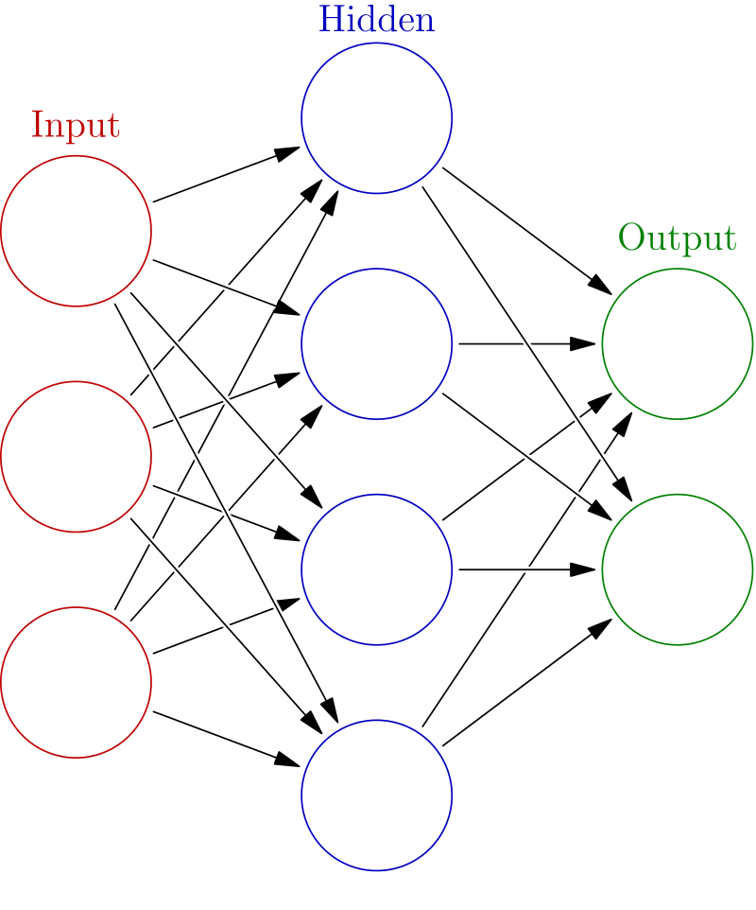
What is a neural network?
Neural network is a systems that "learns" to perform tasks by considering examples, generally without being programmed with task-specific rules.
An artificial neural network is an interconnected group of nodes, inspired by a simplification of neurons in a brain. Here, each circular node represents an artificial neuron and an arrow represents a connection from the output of one artificial neuron to the input of another.

Slide 4
Specification of the problem
The learning should be conducted based on 1000 batteles between TrackFire and set of SittingDuck robots. As an imput variables we use battlefield size and cooling rate of the gun. The output is a number of turns that the battle took to finish.
After the learnig – developed neural network would be tested by generating black and white png in which position of pixel corresponds to specific input and its satturation to acquired by network.

Slide 5
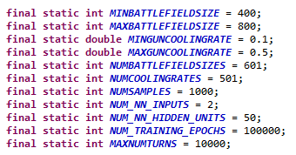
SOLUTION
Constants used for the solutions are created
every constant is pretty self-explainatory. Each value is set acording to the exercise premise. For the comment deserves MAXNUMTURNS which is later used for scaling the output of learning data to [0, 1] range. I acuired its calue by running simulation several times. I noticed that the longest batteles never exceede 9019 turns so just to be safe I set its value to 10000.

Slide 6

Input and output arrays are initialzed
RobocodeEngine is initialized.
Main for loop is started
BattlefieldSize and GunCoolingRate is randomly choosen from legal ranges

Slide 7

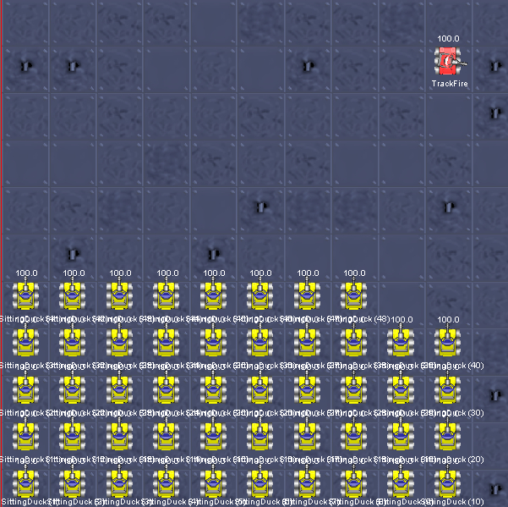
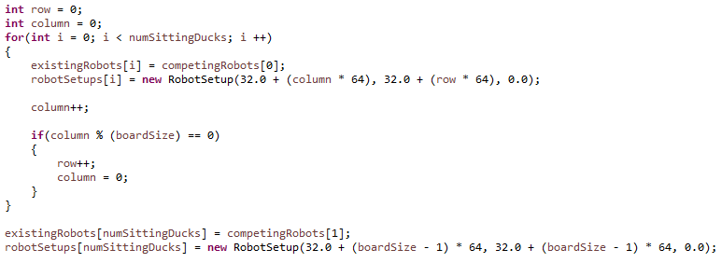
Robots are created
robots arrays are initialized
I decided to divide the board to squares (each of size of 64 pixels, potentially containing one robot)
For consistancy I decided to always place TrackFire in the right upper corner and SittingDuck robots in a grid in left bottom corner
SittingDuck robots and TrackFire are created and placed on the board

Slide 8
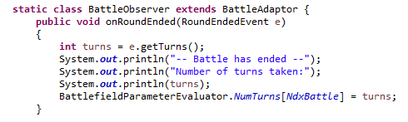
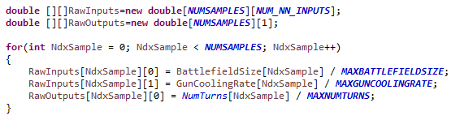
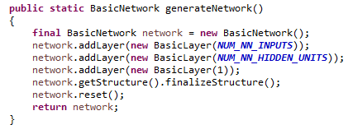
Battle is run
after battle ends there is onRoundEnded event listener called which saves numer of turns in the battle to the NumTurns array to the coresponding battle index.
Input and output arrays are created and filled with values scalled to [0, 1] range.
Neural network is generated

Slide 9
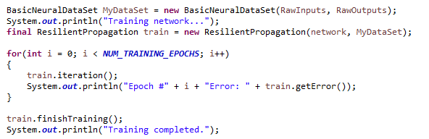
Network is trained

Slide 10
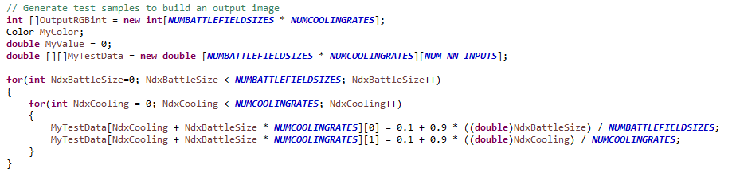
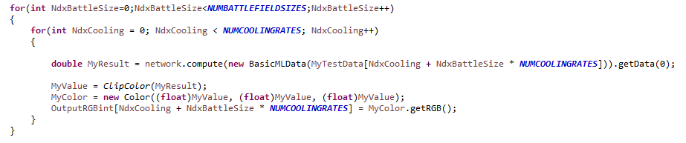
Results are acquired
evenly spaced testing data is generated
trained network is feed with testing data and there is color saturation assigned to its outputs

Slide 11
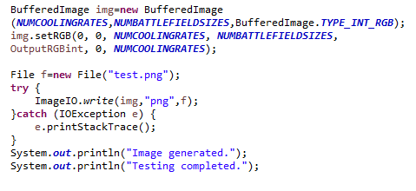
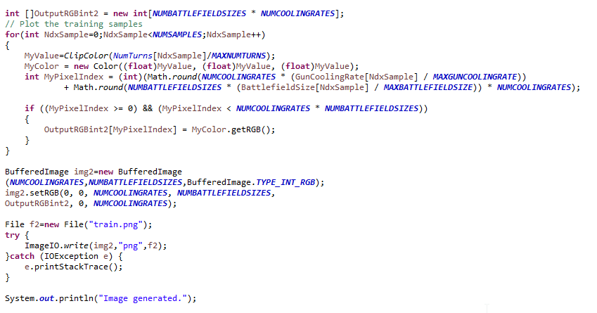
PNG file with pixels saturated acording to results is created
PNG file created the same way but with learing samples is created

Slide 12

Results
cooling rate
board size
As we can see in in the following picture, neural network works as expected. Becaouse the satturation of pixels corresponds to time the robot needs to destroy all the sitting ducks – the whitest part of the picture is in the bottom left corner which corespondes to the situation with the lowest cooling rate and the biggest battlefiled size (biggest nuber of robots to destroy) and it is getting darker as we increase cooling rate or decrese board size.

Slide 13

Training data
cooling rate
board size
In the following picture we can see a bunch of whiter pixeles which represent trainig samples. As expected those pixels don’t reach farmost bottom left corner becaouse they are scaled by dividing acuired value by max value for a given input, and becaouse of that we never reach 0 (min values are bigger than 0).
Coparing that image with the previous one – we can see that neural network indeed corectly works and creates approximates relations between inputs and outputs

Slide 14
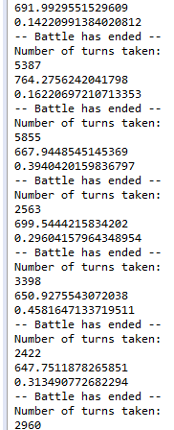
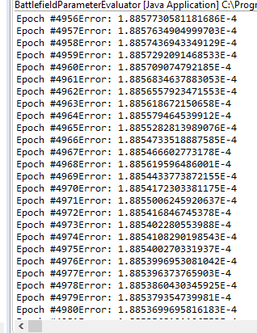
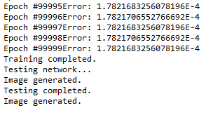
Screenshots of running aplication

Slide 15
What have I learned
What are the problems that could be solved by using neural networks
How to define a problem for solving it with neural networks
How to prepare data for neural netork
How to create neural network and test it

